Slide 1
Name: Thomas Hoad Candidate Number: 2306 School: Calthorpe Park School Subject: Computing Centre Number: 58333
Task 2 Formal Testing – Tom H
Test number: | What to test: | How to test it: | Expected Result: | Actual Result:
1 – A 1 – B 1 – C 1 – D | Can the user save a text file? Can the user enter a sentence? | Press the ‘Compress the text:’ button and a save file dialogue box will appear. After saving the file an input box should appear where the user can enter the sentence. | A file will appear in the selected folder. The sentence will appear in the list box and the text file. “Your sentence is: ASK NOT WHAT YOUR COUNTRY CAN DO FOR YOU ASK WHAT YOU CAN DO FOR YOUR COUNTRY” “Your sentence is: Hello there hello hi” | Positive Positive Positive Positive
2 – A 2 – B | Does the program relay the list of unique words? | After entering a sentence through the input box then the list box will display the list of unique words. Enter: “ASK NOT WHAT YOUR COUNTRY CAN DO FOR YOU ASK WHAT YOU CAN DO FOR YOUR COUNTRY” | “The unique words are: …” “The unique words are: ASK, NOT, WHAT, YOUR, COUNTRY, CAN, DO, FOR, YOU” | Positive Positive

Slide 2
Name: Thomas Hoad Candidate Number: 2306 School: Calthorpe Park School Subject: Computing Centre Number: 58333
Task 2 Formal Testing – Tom H
Test number: | What to test: | How to test it: | Expected Result: | Actual Result:
2 – C 2 – D 2 – E 2 – F 2 – G | Does the program show your unique positions? Does the text file show the unique words and unique positions? | Enter: “Hello there hello hi” After entering a sentence through the input box and displaying the unique words it will also display the unique positions. Enter: “ASK NOT WHAT YOUR COUNTRY CAN DO FOR YOU ASK WHAT YOU CAN DO FOR YOUR COUNTRY” Enter: “Hello there hello hi” Enter your word in the input box after saving your file. Go find the location of your file and open it. | “Your unique words are: hello, there, hi “Your unique positions are: …” “Your unique positions are: 1, 2, 3, 4, 5, 6, 7, 8, 9, 1, 3, 9, 6, 7, 8” “Your unique positions are: 1, 2, 1, 3” The file will open and show the original sentence, unique words and unique positions. | Positive Positive Positive Positive Positive
3 – A | Does the reset button work? | Press the reset button from the menu strip. | The list box will be cleared. | Positive

Slide 3
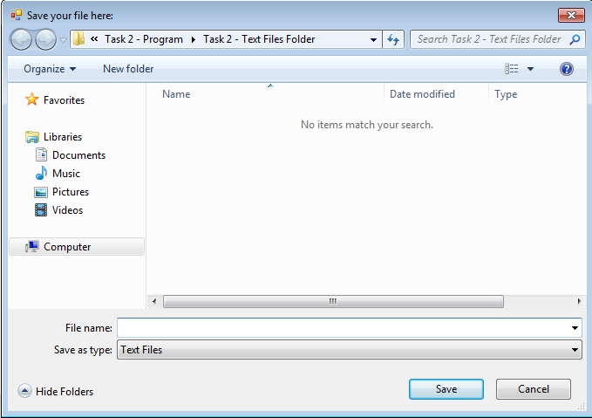
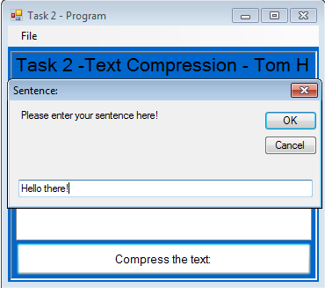
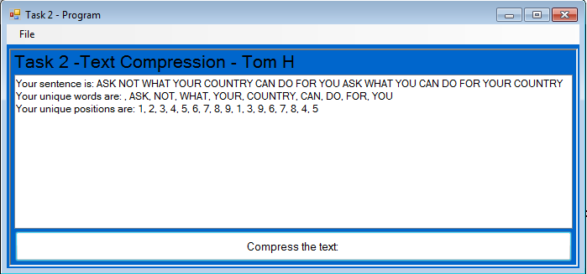
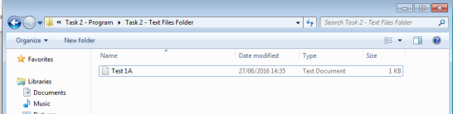
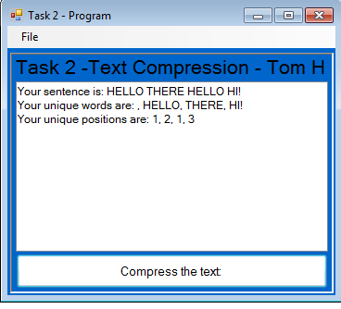
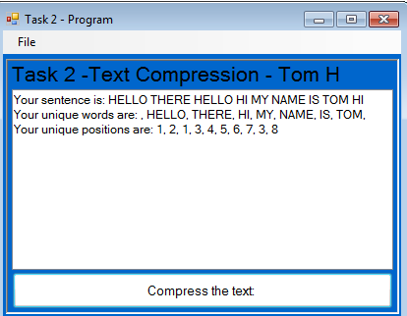
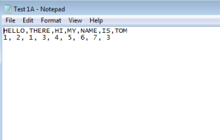
Name: Thomas Hoad Candidate Number: 2306 School: Calthorpe Park School Subject: Computing Centre Number: 58333
Task 2 Formal Testing – Tom H
Test number: | What to test: | How to test it: | Expected Result: | Actual Result:
3 – B | Does the exit button work? | Press the exit button from the menu strip. | A warning box will appear warning you of the program closing and will then close the program. | Positive
4 – A 4 - B | Has a sentence been entered or not? Has a name been given to the file that will be saved? | Enter a blank sentence. Don’t name the file and try to save. | An error message should appear saying that noting has been entered. An error message should appear saying that no file name has been entered. | Positive Positive
Testing screenshots:
Figure 1 – A: Figure 1 – B: Figure 1 – C & 2 – B & 2 – E:
Figure 1 – D & 2 – C & 2 – F: Figure 2 – A & 2 – D Figure 2 – G:

Slide 4
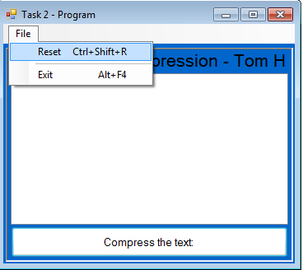
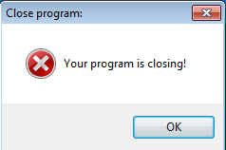
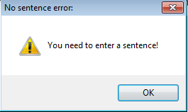
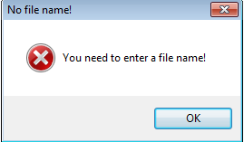
Name: Thomas Hoad Candidate Number: 2306 School: Calthorpe Park School Subject: Computing Centre Number: 58333
Task 2 Formal Testing – Tom H
Figure 3 – A: Figure 3 – B: Figure 4 – A:
Figure 4 – B:

